Slide 1
DEPARTMENT OF ADMINISTRATION preserving the past, serving people today, planning for tomorrow
2020-2021
Fleet CIP Presentation
August 27, 2020
LAURA E. FREED, Director
Robbie Burgess, Administrator

Slide 2
DEPARTMENT PRIORITY
Support, promote and enhance
government efficiency and innovation
to provide Nevadans
with quality access to government services

Slide 3
Department of Administration
Fleet Services Division
The division provides safe, efficient, environmentally-friendly and cost-effective ground transportation solutions to state employees.

Slide 4
Services Provided
Long Term Assigned Vehicle Management
(967 units) – Vegas Region (612 units)
Short Term Assigned Vehicle Management
(75 units) – Vegas Region (37)
Vegas 92 Unit Increase SFY 2020
Shop Tech to ratio 172:1

Slide 5
Services Provided Within Those Activities
Maintenance
Long Range Fleet Planning for Agencies
Acquisition and Disposal of Vehicles
Reporting
Fueling & Cleaning
Accident Management
Facilitation – “Our key function” is to create solutions to solve our customer’s problems which saves our customers $$ through time management

Slide 6
Division Philosophy
  To provide state agencies modern solutions to solve their transportation needs in a cost effective manner utilizing technology, strategic fleet management and industry best practices to enhance our customers experience and control cost.

Slide 7
Division Strategy
  The division partners closely with the private sector to ensure the product we deliver to our customers is delivered in an efficient and cost effective manner whilst focusing on one goal – Solve our customers’ issues quickly and efficiently.
  The division outsources approximately 20% of our short-term rentals and multiple types of vehicle repairs.

Slide 8
Vehicle Types Provided by Fleet Services
Sedans, Sport Utility Vehicles, Police Vehicles, Light Duty Trucks, Heavy Duty Trucks and Vans.

Slide 9
State Fiscal Year 2020 Statistics
Staff – 16
Statewide Fleet Size – 1229
Vegas Fleet Size – 612
Clark County State Workforce – 8000
Facilities (3) Carson City, Reno, Las Vegas
Fleet Miles Traveled 8.6 Million
Statewide Short-Term rental day processed – 12,400
Statewide Vehicle Repair Requests Facilitated – 3,250

Slide 10
Why Fleet Management
Cost containment through the strategic management of resources,locations and assets
Industry expertise – fleet descisions are based on factual data, fleet experience, and industry specific knowledge – not personal preference or personal experiences
Consolidation of resources reduces FTE’S = $$ savings

Slide 11
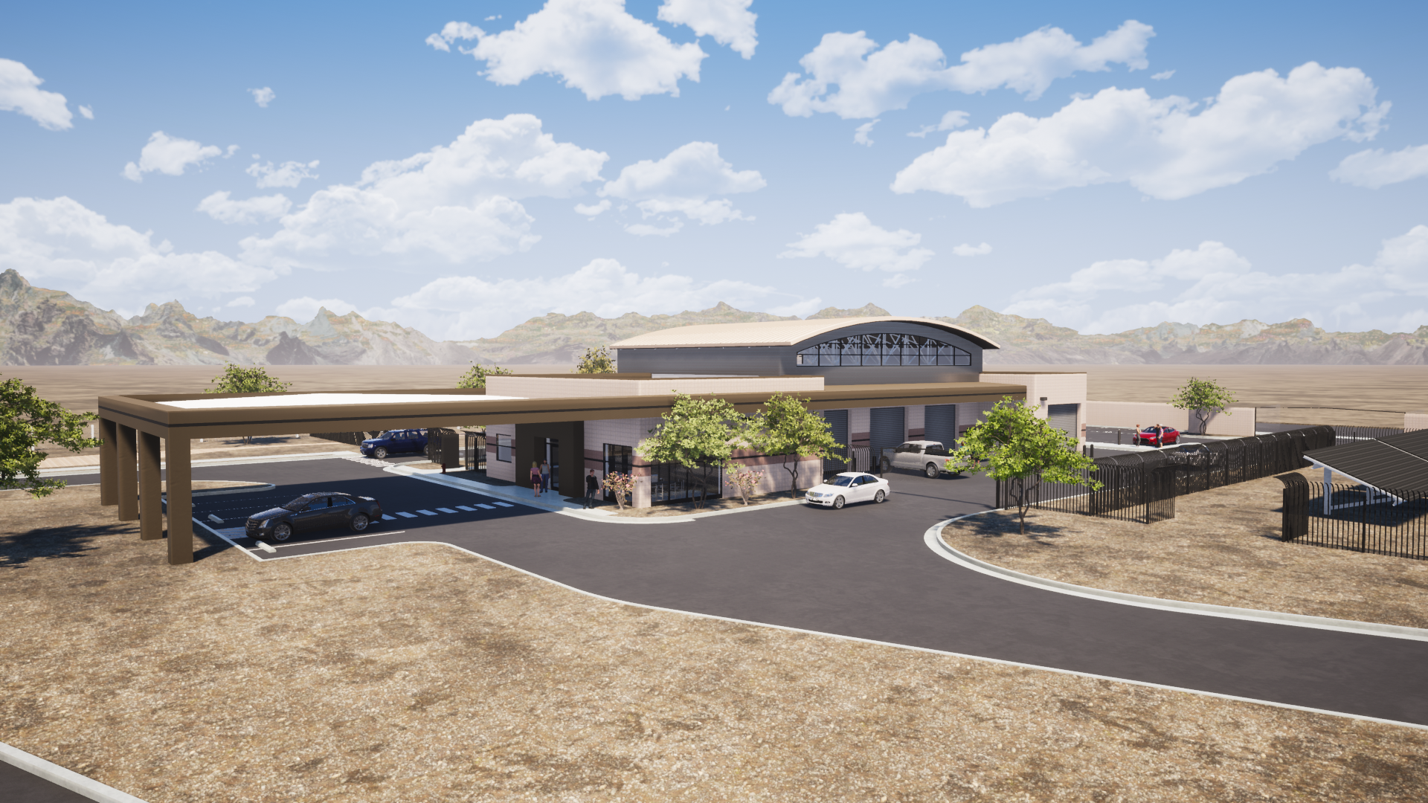
Southwest View

Slide 12
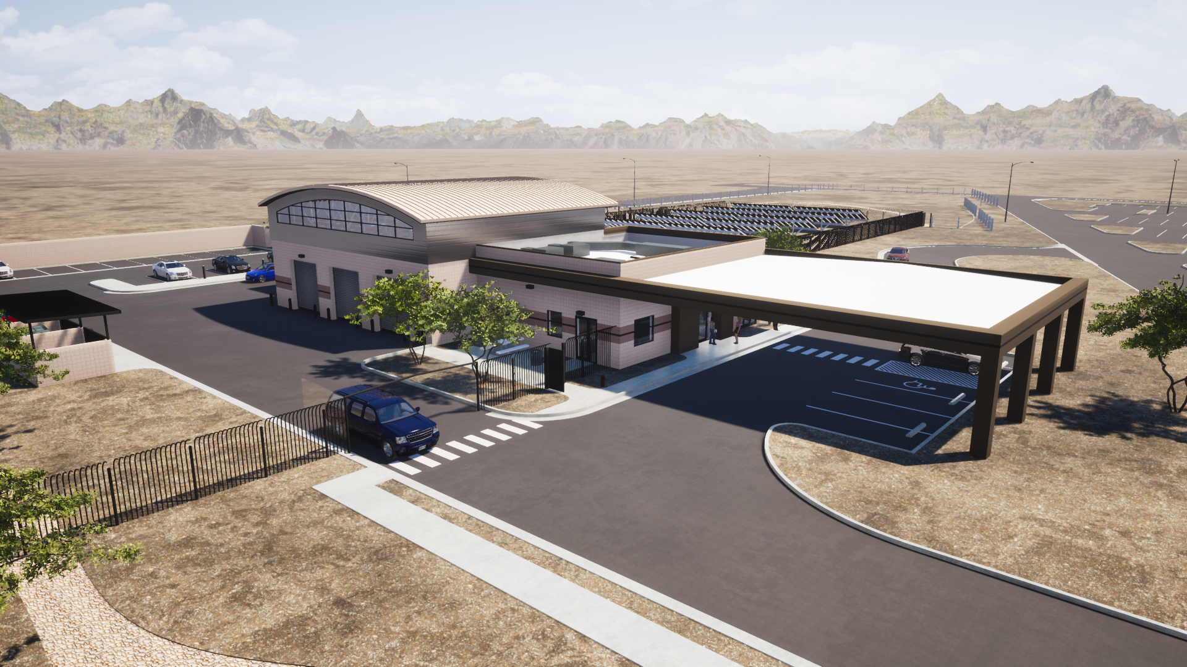
Northwest View

Slide 13
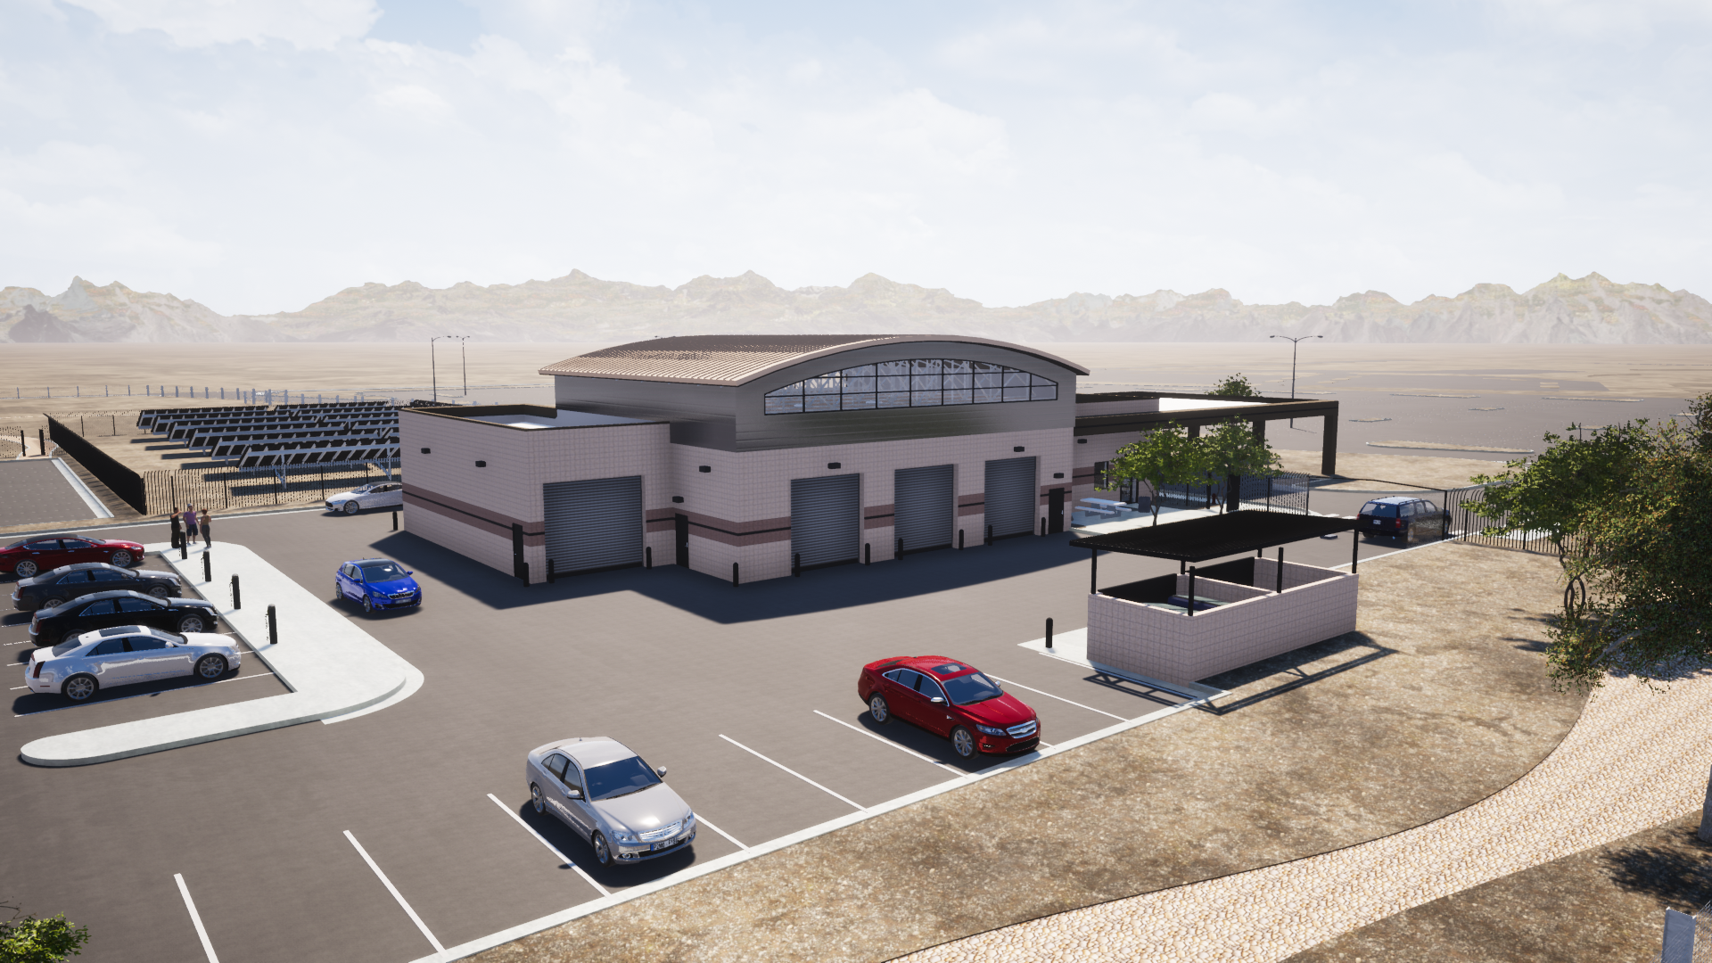
Northeast View

Slide 14
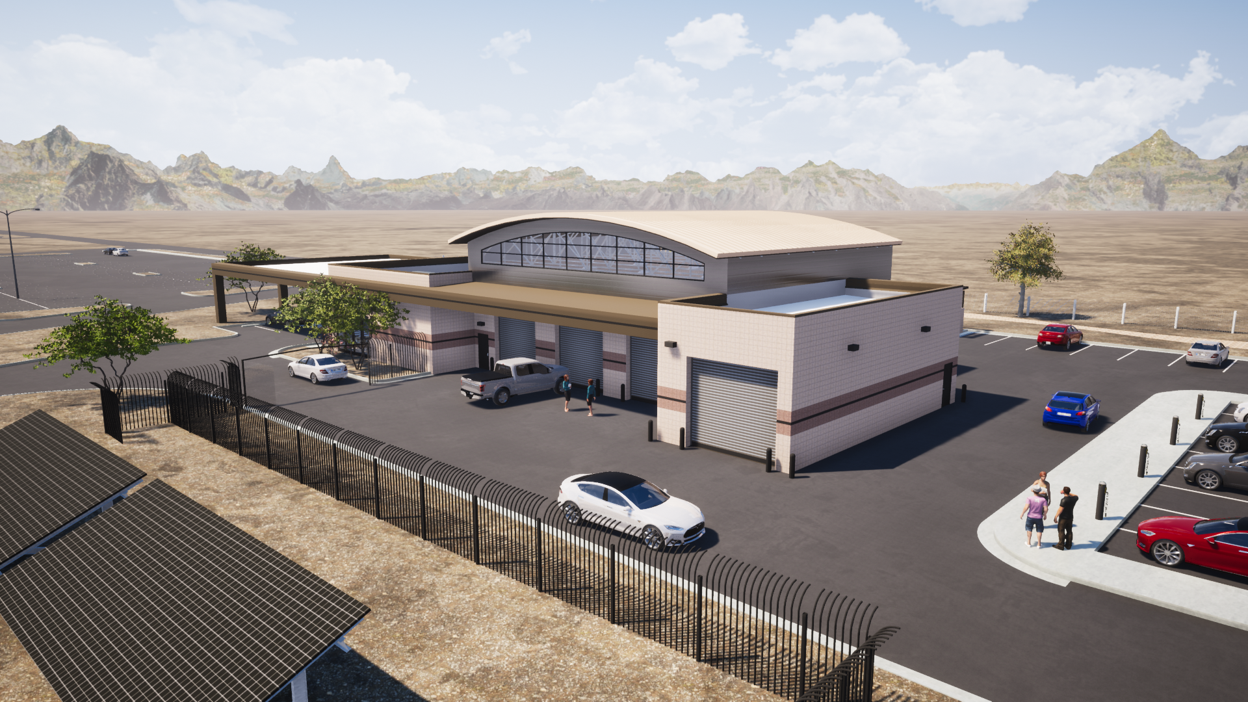
Southeast View

Slide 15
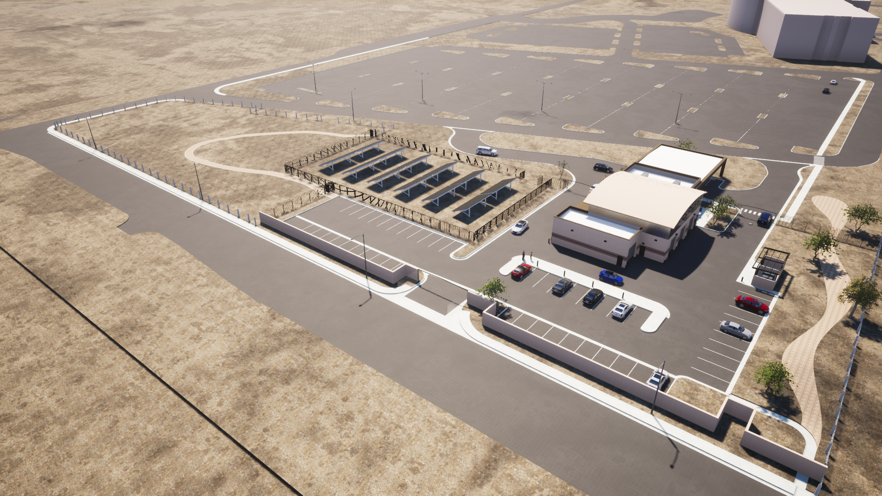
Site Aerial View

